Slide 1
UNIT-IV Classification

Slide 2
Classification and Predication in Data Mining
There are two forms of data analysis that can be used to extract models describing important classes or predict future data trends. These two forms are as follows:
Classification
Prediction
We use classification and prediction to extract a model, representing the data classes to predict future data trends. Classification predicts the categorical labels of data with the prediction models. This analysis provides us with the best understanding of the data at a large scale.
Classification models predict categorical class labels, and prediction models predict continuous-valued functions. For example, we can build a classification model to categorize bank loan applications as either safe or risky or a prediction model to predict the expenditures in dollars of potential customers on computer equipment given their income and occupation.

Slide 3
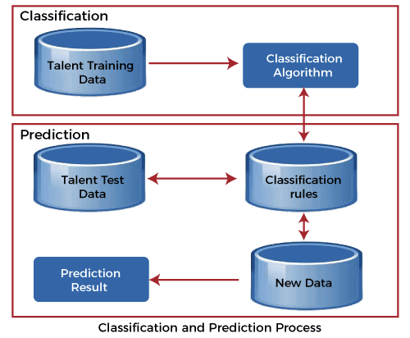

Slide 4
What is Classification?
Classification is to identify the category or the class label of a new observation. First, a set of data is used as training data. The set of input data and the corresponding outputs are given to the algorithm. So, the training data set includes the input data and their associated class labels. Using the training dataset, the algorithm derives a model or the classifier. The derived model can be a decision tree, mathematical formula, or a neural network. In classification, when unlabeled data is given to the model, it should find the class to which it belongs. The new data provided to the model is the test data set.
Classification is the process of classifying a record. One simple example of classification is to check whether it is raining or not. The answer can either be yes or no. So, there is a particular number of choices. Sometimes there can be more than two classes to classify. That is called multiclass classification.

Slide 5
The bank needs to analyze whether giving a loan to a particular customer is risky or not. For example, based on observable data for multiple loan borrowers, a classification model may be established that forecasts credit risk. The data could track job records, homeownership or leasing, years of residency, number, type of deposits, historical credit ranking, etc. The goal would be credit ranking, the predictors would be the other characteristics, and the data would represent a case for each consumer. In this example, a model is constructed to find the categorical label. The labels are risky or safe.

Slide 6
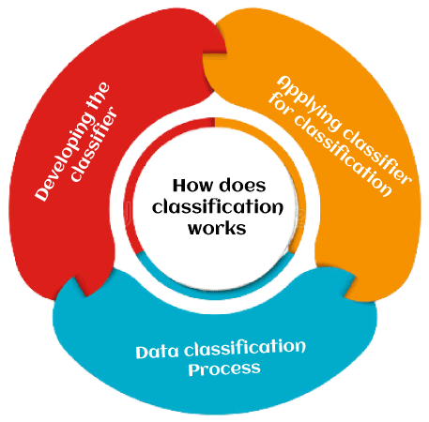
How does Classification Works?
The functioning of classification with the assistance of the bank loan application has been mentioned above. There are two stages in the data classification system: classifier or model creation and classification classifier.

Slide 7
1. Developing the Classifier or model creation: This level is the learning stage or the learning process. The classification algorithms construct the classifier in this stage. A classifier is constructed from a training set composed of the records of databases and their corresponding class names. Each category that makes up the training set is referred to as a category or class. We may also refer to these records as samples, objects, or data points.
2. Applying classifier for classification: The classifier is used for classification at this level. The test data are used here to estimate the accuracy of the classification algorithm. If the consistency is deemed sufficient, the classification rules can be expanded to cover new data records. It includes:
Sentiment Analysis
Document Classification
Image Classification

Slide 8
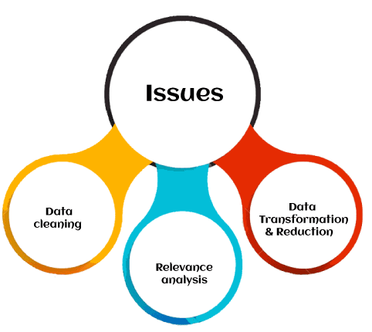
Classification Issues
The major issue is preparing the data for Classification. Preparing the data involves the following activities, such as:

Slide 9
Data Cleaning: Data cleaning involves removing the noise and treatment of missing values. The noise is removed by applying smoothing techniques, and the problem of missing values is solved by replacing a missing value with the most commonly occurring value for that attribute.
Relevance Analysis: The database may also have irrelevant attributes. Correlation analysis is used to know whether any two given attributes are related.
Data Transformation and reduction: The data can be transformed by any of the following methods.
Normalization: The data is transformed using normalization. Normalization involves scaling all values for a given attribute to make them fall within a small specified range. Normalization is used when the neural networks or the methods involving measurements are used in the learning step.
Generalization: The data can also be transformed by generalizing it to the higher concept. For this purpose, we can use the concept hierarchies.

Slide 10
Comparison of Classification Methods
Accuracy: The accuracy of the classifier can be referred to as the ability of the classifier to predict the class label correctly, and the accuracy of the predictor can be referred to as how well a given predictor can estimate the unknown value.
Speed: The speed of the method depends on the computational cost of generating and using the classifier or predictor.
Robustness: Robustness is the ability to make correct predictions or classifications. In the context of data mining, robustness is the ability of the classifier or predictor to make correct predictions from incoming unknown data.
Scalability: Scalability refers to an increase or decrease in the performance of the classifier or predictor based on the given data.
Interpretability: Interpretability is how readily we can understand the reasoning behind predictions or classification made by the predictor or classifier.

Slide 11
Decision Tree Classification Algorithm

Slide 12
Decision Tree is a Supervised learning technique that can be used for both classification and Regression problems, but mostly it is preferred for solving Classification problems. It is a tree-structured classifier, where internal nodes represent the features of a dataset, branches represent the decision rules and each leaf node represents the outcome.
In a Decision tree, there are two nodes, which are the Decision Node and Leaf Node. Decision nodes are used to make any decision and have multiple branches, whereas Leaf nodes are the output of those decisions and do not contain any further branches.
The decisions or the test are performed on the basis of features of the given dataset.
It is a graphical representation for getting all the possible solutions to a problem/decision based on given conditions.
It is called a decision tree because, similar to a tree, it starts with the root node, which expands on further branches and constructs a tree-like structure.
In order to build a tree, we use the CART algorithm, which stands for Classification and Regression Tree algorithm.
A decision tree simply asks a question, and based on the answer (Yes/No), it further split the tree into subtrees.

Slide 13


Slide 14
Decision Tree Terminologies
Root Node: Root node is from where the decision tree starts. It represents the entire dataset, which further gets divided into two or more homogeneous sets.
Leaf Node: Leaf nodes are the final output node, and the tree cannot be segregated further after getting a leaf node.
Splitting: Splitting is the process of dividing the decision node/root node into sub-nodes according to the given conditions.
Branch/Sub Tree: A tree formed by splitting the tree.
Pruning: Pruning is the process of removing the unwanted branches from the tree.
Parent/Child node: The root node of the tree is called the parent node, and other nodes are called the child nodes.

Slide 15
How does the Decision Tree algorithm Work?
In a decision tree, for predicting the class of the given dataset, the algorithm starts from the root node of the tree. This algorithm compares the values of root attribute with the record (real dataset) attribute and, based on the comparison, follows the branch and jumps to the next node.
For the next node, the algorithm again compares the attribute value with the other sub-nodes and move further. It continues the process until it reaches the leaf node of the tree. The complete process can be better understood using the below algorithm:
Step-1: Begin the tree with the root node, says S, which contains the complete dataset.
Step-2: Find the best attribute in the dataset using Attribute Selection Measure (ASM).
Step-3: Divide the S into subsets that contains possible values for the best attributes.
Step-4: Generate the decision tree node, which contains the best attribute.
Step-5: Recursively make new decision trees using the subsets of the dataset created in step -3. Continue this process until a stage is reached where you cannot further classify the nodes and called the final node as a leaf node

Slide 16
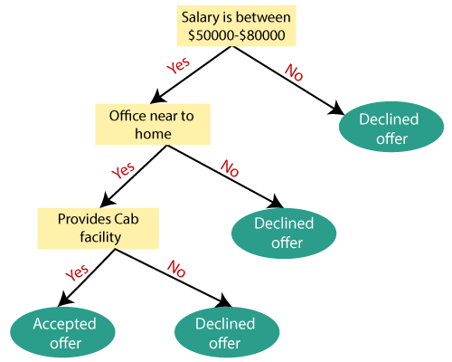
Example: Suppose there is a candidate who has a job offer and wants to decide whether he should accept the offer or Not. So, to solve this problem, the decision tree starts with the root node (Salary attribute by ASM). The root node splits further into the next decision node (distance from the office) and one leaf node based on the corresponding labels. The next decision node further gets split into one decision node (Cab facility) and one leaf node. Finally, the decision node splits into two leaf nodes (Accepted offers and Declined offer). Consider the below diagram:

Slide 17
Advantages of the Decision Tree
It is simple to understand as it follows the same process which a human follow while making any decision in real-life.
It can be very useful for solving decision-related problems.
It helps to think about all the possible outcomes for a problem.
There is less requirement of data cleaning compared to other algorithms.
Disadvantages of the Decision Tree
The decision tree contains lots of layers, which makes it complex.
It may have an overfitting issue, which can be resolved using the Random Forest algorithm.
For more class labels, the computational complexity of the decision tree may increase.

Slide 18
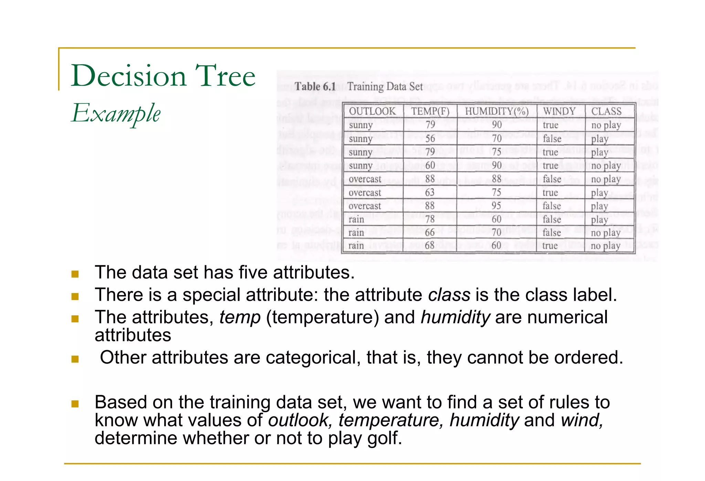

Slide 19
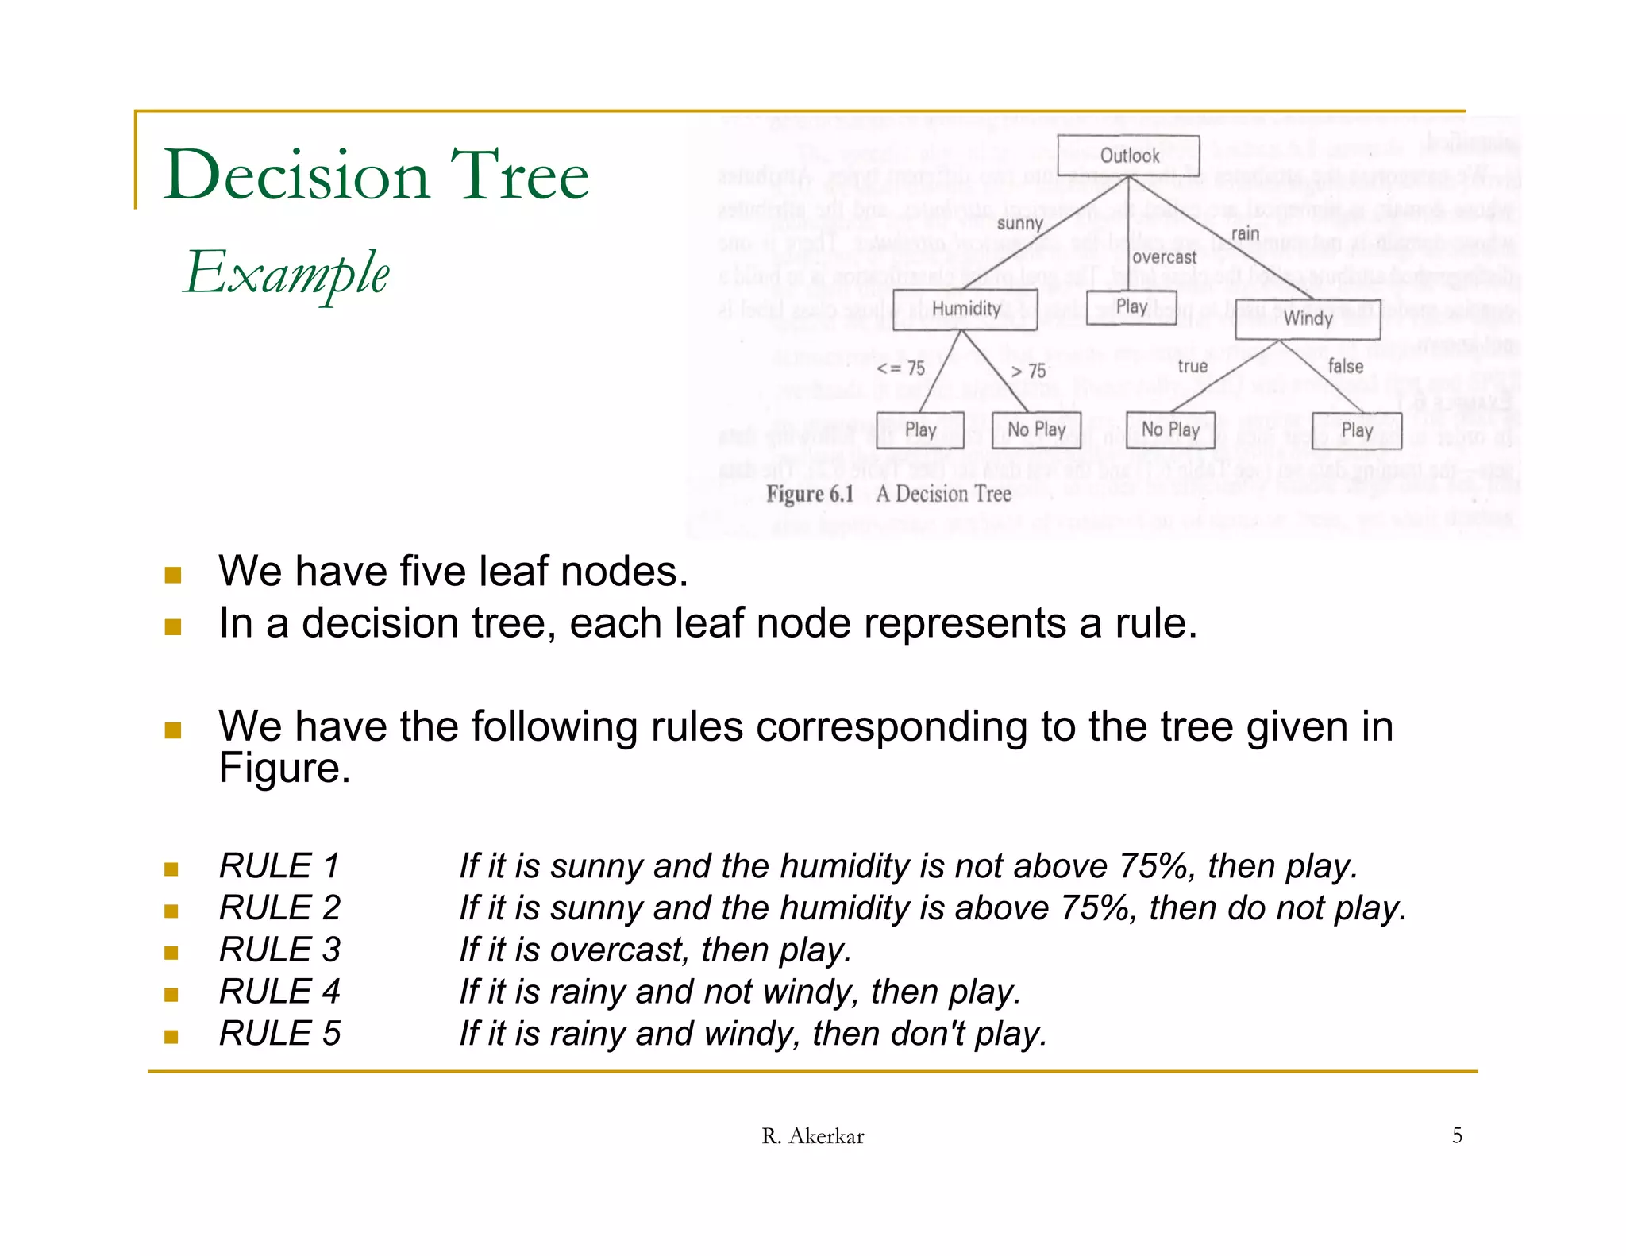

Slide 20
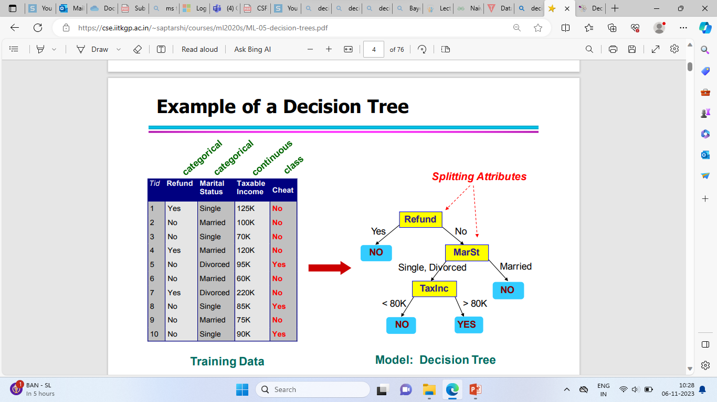

Slide 22
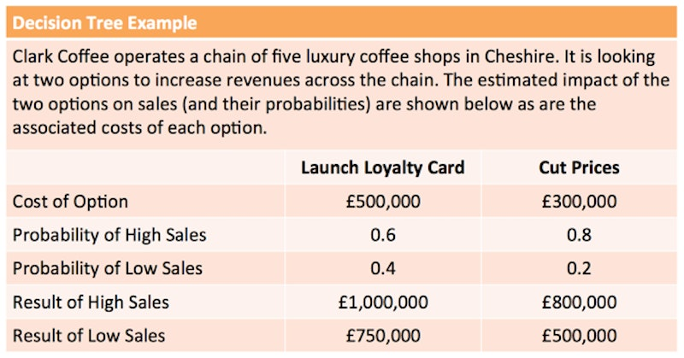

Slide 23
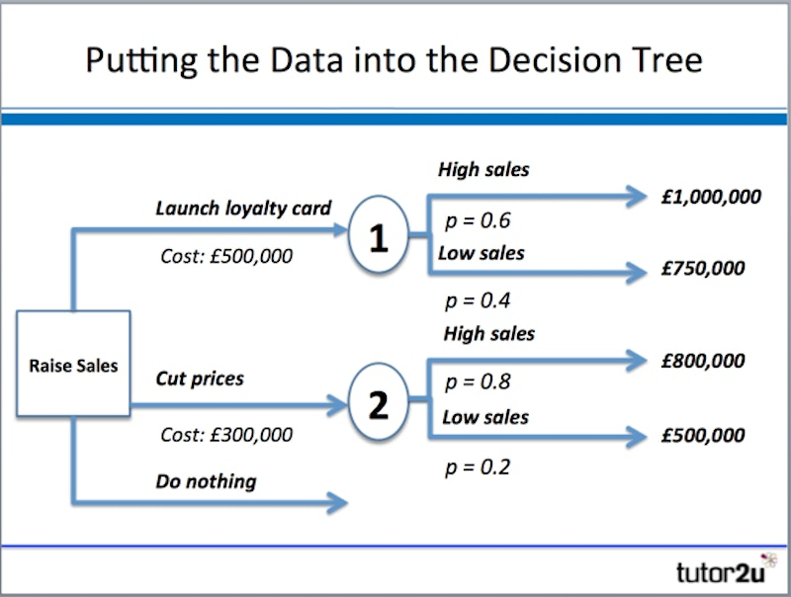

Slide 24
Option: Launch loyalty card:
High sales: (0.6 x £1,000,000) = £600,000
Low sales: (0.4 x £750,000) = £300,000
Total expected value = £900,000
Net gain: £900,000 - £500,000 = £400,000
Option: Cut prices:
High sales: (0.8 x £800,000) = £640,000
Low sales: (0.2 x £500,000) = £100,000
Total expected value = £740,000
Net gain: £740,000 - £300,000 = £440,000
Both options indicate a positive net gain, suggesting that either would be better than doing nothing.
However, cutting prices has a slightly higher net gain & looks the best option of the two considered.

Slide 25
Data Mining Bayesian Classifiers

Slide 26
Bayesian classification uses Bayes theorem to predict the occurrence of any event. Bayesian classifiers are the statistical classifiers with the Bayesian probability understandings. The theory expresses how a level of belief, expressed as a probability.
Bayes theorem came into existence after Thomas Bayes, who first utilized conditional probability to provide an algorithm that uses evidence to calculate limits on an unknown parameter.
Bayesian classifier can predict the probability that a given tuple belongs to a particular class.
It is based on Bayes’ theorem.
Bayesian classifier gives more speed and accuracy as compared to Decision tree classifier.
First we recall the Bayes’ theorem in probability then we will understand the working of Bayesian classification method.

Slide 27

Bayes's theorem is expressed mathematically by the following equation that is given below.
Where X and Y are the events and P (Y) ≠ 0
P(X/Y) is a conditional probability that describes the occurrence of event X is given that Y is true.
P(Y/X) is a conditional probability that describes the occurrence of event Y is given that X is true.
P(X) and P(Y) are the probabilities of observing X and Y independently of each other. This is known as the marginal probability.

Slide 28
Backpropagation in Data Mining

Slide 29
Backpropagation is an algorithm that backpropagates the errors from the output nodes to the input nodes. Therefore, it is simply referred to as the backward propagation of errors. It uses in the vast applications of neural networks in data mining like Character recognition, Signature verification, etc.
Neural Network:
Neural networks are an information processing paradigm inspired by the human nervous system. Just like in the human nervous system, we have biological neurons in the same way in neural networks we have artificial neurons, artificial neurons are mathematical functions derived from biological neurons. The human brain is estimated to have about 10 billion neurons, each connected to an average of 10,000 other neurons. Each neuron receives a signal through a synapse, which controls the effect of the signconcerning on the neuron.

Slide 30
Backpropagation:
Backpropagation is a widely used algorithm for training feedforward neural networks. It computes the gradient of the loss function with respect to the network weights. It is very efficient, rather than naively directly computing the gradient concerning each weight. This efficiency makes it possible to use gradient methods to train multi-layer networks and update weights to minimize loss; variants such as gradient descent or stochastic gradient descent are often used.
The backpropagation algorithm works by computing the gradient of the loss function with respect to each weight via the chain rule, computing the gradient layer by layer, and iterating backward from the last layer to avoid redundant computation of intermediate terms in the chain rule.

Slide 31
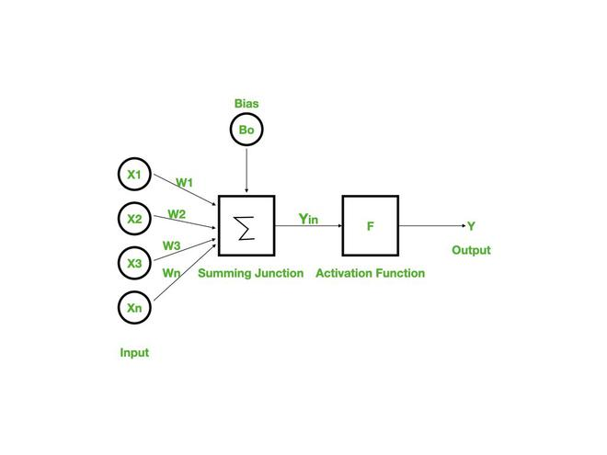

Slide 32
Features of Backpropagation:
it is the gradient descent method as used in the case of simple perceptron network with the differentiable unit.
it is different from other networks in respect to the process by which the weights are calculated during the learning period of the network.
training is done in the three stages :
the feed-forward of input training pattern
the calculation and backpropagation of the error
updation of the weight

Slide 33
Working of Backpropagation:
Neural networks use supervised learning to generate output vectors from input vectors that the network operates on. It Compares generated output to the desired output and generates an error report if the result does not match the generated output vector. Then it adjusts the weights according to the bug report to get your desired output.
Backpropagation Algorithm:
Step 1: Inputs X, arrive through the preconnected path.
Step 2: The input is modeled using true weights W. Weights are usually chosen randomly.
Step 3: Calculate the output of each neuron from the input layer to the hidden layer to the output layer.
Step 4: Calculate the error in the outputs
Backpropagation Error= Actual Output – Desired Output

Slide 34
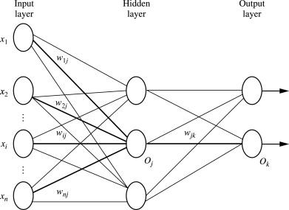
Step 5: From the output layer, go back to the hidden layer to adjust the weights to reduce the error.
Step 6: Repeat the process until the desired output is achieved.
Parameters :
x = inputs training vector x=(x1,x2,…………xn).
t = target vector t=(t1,t2……………tn).
δk = error at output unit.
δj = error at hidden layer.
α = learning rate.
V0j = bias of hidden unit j.

